Slide 1

Metrics: How to Track Things That Matter
November 2006
Clyneice Chaney CQMgr., CQA, PMP
Software Test & Performance Conference
cchaney@ppc.com

Slide 2
Agenda
01 Trends….Why Metrics?
02 Implementing…. How Metrics
03 Choosing…. What Metrics?

Slide 3

Remember the Good Old Days?
When no one really knew what took place in IT?
Before number crunchers recognized IT as source of ROI or Profit?
Before IT became the hub of the universe?

Slide 4

HOW TIMES HAVE CHANGED!
New Mantra!
Accomplish More with Less!
Optimize Application Quality
Show a Return on Resources

Slide 5
How Do You Respond?
How may test cycles should you plan for? I mean exactly!
When will the software be ready? Really?
How do you know?
Are the customer’s needs being met? Prove it!
Metrics!
Notes:
Can you answer these questions?
When the pressure is on to provide hard data to support your estimates, you need metrics.
Lord Kelvin: when you can measure what you are speaking about, and express it in numbers, you know something about it
But when you cannot measure it, when you cannot express it, in numbers, your knowledge is of a meager kind.

Slide 6

But Metrics …… Their Dirty Words!
Can’t agree on metrics to use
Metrics make us look bad!
No one is paying attention to them
Notes:
We don’t know what we don’t know
We can’t act on what we don’t know.
We don’t know until we search
We don’t search for what we don’t question
We don’t question, what we don’t measure

Slide 7

Getting People to Want Metrics
Make them easy to understand, use, and access
Notes:
To get people to actually want metrics, show them how they relate to the bottom line., often the customer
Use pictures and graphs to make data accessible and easy to understand at a glance
Keep your reports focused on the big picture by showing a product’s performance over time
Make a few quality “flagship” measures that are consistent across all products

Slide 8

Getting People to Want Metrics
Identify Accomplishments or
Goals
and tie metrics to them
Notes:
Use victor basillis goal /;question metric paradigm establish goals that you need to accomplish:

Slide 9
Metrics that Matter: It’s all in the Goal
Goals:
Improve Project planning
Increase defect containment
Increase software reliability
Improve customer service
Increase software productivity
Notes:
We measure the product in effort to better understand it’s quality and to better prepare for installation.
We measure process to develop more accurate estimates for future development and to better understand the efficacy of the process itself.
Only rational way to improve something is to measure it , use metrics as indicator for going forward

Slide 10

Getting People to Want Metrics
Getting Management to Pay attention:
Find A key Metric– Report it at High level
OR
Find a key metric- report during product reviews
Notes:
Get one champion
Get a highline manger to report on one– find a way to someone in executive meetings. Have them present one key metric i.e. WDC as part of regular update to the executive team
Success is a great attractor
Start at bottom, get a product manager to report on one key metric during product reviews. Once one group is publicizing and reporting on metrics, other groups will start.
Show them how they relate to the bottom line, often the customer
Have a few flagship quality measures that are used for all projects

Slide 11


Getting People to Want Metrics
Everyone doesn’t
wear same style shoe
Notes:
What do Executives Want to know?
Bottom line
Responsibility
Means for quick evaluation
Customer Focus
Overall performance
Overall quality efforts, but little or no detail. Pick one key metric that focuses attention on an area of critical importance
When you start showing metrics, particularly comparative data between products, start asking questions. Remember you don’t question what you don’t measure.
Quarterly rollups are great for executives
Tailor metrics to meet different needs
Executives
Project Manager
Test Management
Different teams within an organizations have different needs. Product teams, sales, management all have different needs.
Product teams need to see what can lead them to improvements. Need easy access for all team members.
What do Executives Want to know?
Bottom line
Responsibility
Means for quick evaluation
Customer Focus
Overall performance
Provide product focused metrics at least monthly for team meetings and review meetings with management. IE new releases, may want to review incoming defect rate, look at backlog. Customer satisfaction metrics ;may be important for future enhancements

Slide 12

Metrics that Matter: Implement in Stages
First Step:
Management
visibility
Second Step:
Graduated usage
Third Step:Success is a great attractor
Notes:
Get one champion
Get a highline manger to report on one
Success is a great attractor
To be successful, metrics must be a part of the culture, reviewed regularly, and acted jupon by the teams.

Slide 13

Choosing the Right
Metrics?

Slide 14
Metrics for a Customer Focus
Incoming Defect Rates
Backlog
Weighted Defect Count
Support Calls
Hot Site Index
Overall quality
Notes:
Customer focused metrics in quality should give a view of the customer satisfaction. Customer satisfaction is impacted by the number of defects they run into as well as how critical they are and our response in fixing them.

Slide 15
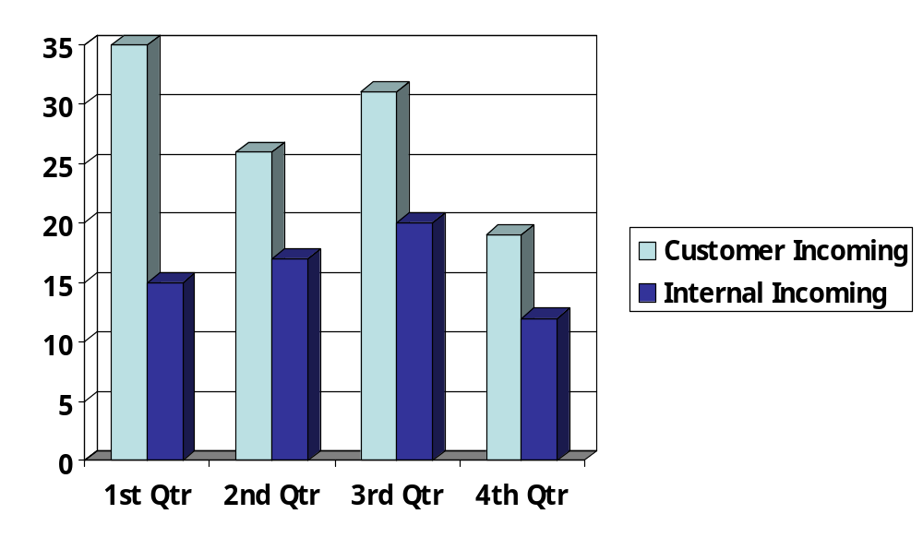
Incoming Defect Rate
Notes:
Incoming defect rates provides a customer focus metrics, know what your customer it dealing with. It also provides an indication of your defect removal process. If you rate of new bugs in the field is high compared to your detection rate prior to production – get view of how good your quality process of not delivering defects.

Slide 16
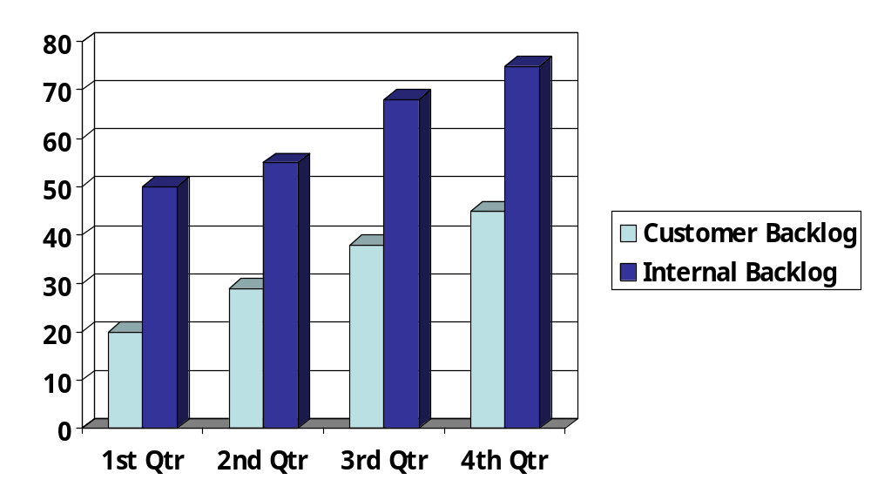
Defect Backlog Graph
Backlog of Open Defects Product A
Notes:
Backlog- view of both product quality and customer responsiveness– How many open you have as well as how long it takes to get fixes out. If backlog is high– chances are good that you have unhappy frustrated customers

Slide 17
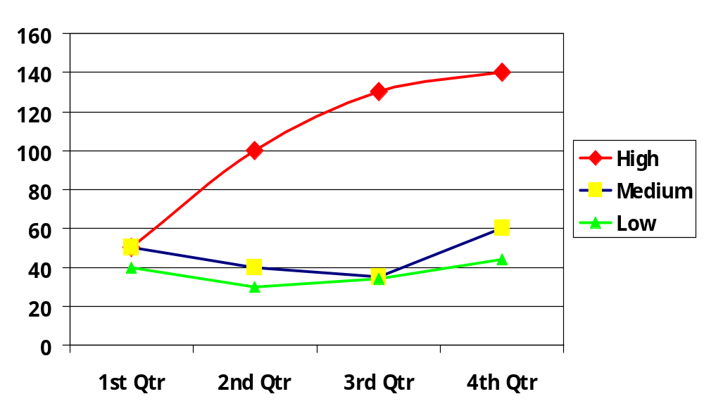
Weighted Defect of Backlog
Notes:
Weighted defect count– criticality of open bugs give good view of product quality. This metric calculates weights to a backlogged defect based upon its criticality. If you look at customer reported and ones, provides two views: quality and customer responsiveness
High = rating is 10; defects 5, 10, 12, and 14
Medium rating is 5, defects 10, 8,7,12
Low rating is 2, defects 20,15,17, 22

Slide 18
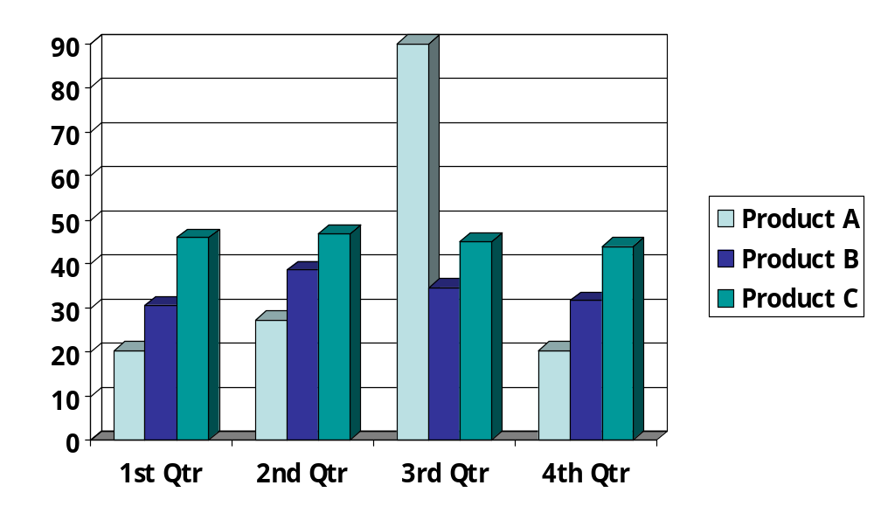
Support Calls Received
Notes:
Support calls- break down customer calls into categories such as usage, bugs, installation, enhancements etc gives you idea of how often customers need support and types of problems they have

Slide 19
Hot Site Index
Alert site- unverified customer reported problem
Hot site- verified significant customer reported problem
Weigh each alert or hot site by the number of weeks or days that the site has been hot
Add up the value for each site to get the hot site index

Slide 20
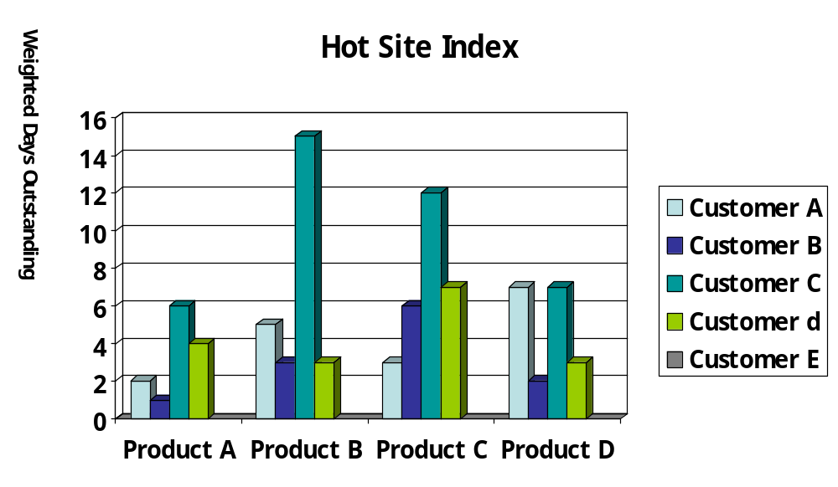
Hot site Index

Slide 21

Metrics from a Product Perspective:
What would Product
Organization want to know?
  Quality level of product
  Customer satisfaction with pro duct
  Status of product in development

Slide 22
Product Perspective Metrics
Requirements Stability | Original Num/Total Req.
Program Defect Density | Num defects/length source code
Backlog of Open Bugs | Count of bugs/ over time; Weighted
Support Calls Received | Count /over time; weighted
Product Quality Over Time | Weighted defect count by month; quarter
Defects by Lifecycle Phase | Count of defects detected by phase detected

Slide 23
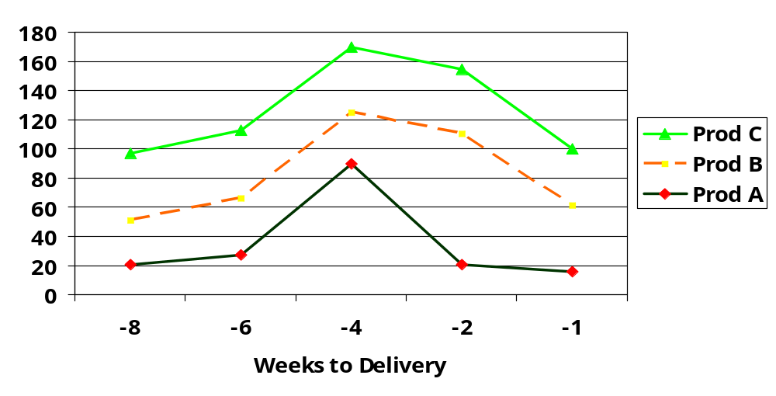
Defect Arrival Rates
Notes:
Can compare relative to general arrival date on single product or among releases. How do they peak. Do they decline in normal expected fashion.

Slide 24

Metrics from a Test Organization Perspective
What would Test
Organization want to know?
  Quality level of product
  Customer satisfaction w/ product
  Status of product in testing
  Organization’s ability to perform
  function

Slide 25
Metrics from a Test Organization Perspective:
Number of defects discovered during testing (counting defects)
Duration of Testing Process (elapsed hours)
Test Effectiveness Ratio
Requirements stability
Product Stabilization
Defect detection capability
Test Planning effectiveness
Defect Containment
Notes:
Test effectiveness ratio Num items covered /total num of items

Slide 26
Testing Related Metrics
Bug density | Number of bugs by severity for each component
Productivity Variance | Planned effort – actual effort/planned effort )* 100
Milestone variance | Total due/total met * 100
Defect detection capability | Detected defects/total time spent
Test effectiveness | Bugs found test/total bugs found*100
Test effort | Tests conducted/total test * 100
Test effort performance | Bugs fixed/total bugs found *100
Notes:
Productivity variance good for assessing organizational capability
Milestone variance good for monitoring if meeting commitments on time very time/ monthly
Defect detection capability of qa and qc activities in detecting defects. Trend line are good. Can do defects detected per hour to get input into training needs. If you look at phases i.e. requirements, qa testing, integration testing.
Simple counts work count, number of bugs, number of tests, time for tests
Test coverage – total inventory of tests. This is a relative number, can’t find all the tests that could be performed.
Effectiveness want a ratio of the number of bugs found by test set to the total number found in product. Total bugs = total found in test plus total found elsewhere. An effective test suite will maximize number of bugs found in effort. Rapid or risk based approaches this is important. Looking
Test effort performance goal of test effort to minimize number of bugs found by users. Performance of test effort is based on ratio of total bugs found and fixed during testing to all bugs found in the system.

Slide 27
Metrics to Track Testing
Number of tests attempted by given time
Number of tests passed by a given time
Number of bugs found by given time
Number of bugs fixed by given time
Average time between failures

Slide 28
Test Progress Tracking
 | # Tests Plan | %Attempt | % Successful | # Not Attempted | % Total Attempted | % Total Successful
Product A | 60577 | 90.19 | 87.72 | 5940 | 68.27 | 66.1
Product B | 1043 | 66.88 | 28.19 | 246 | 38.83 | 15.5
Product C | 277 | 0 | 0 | 277 | 0 | 0
Product D | 232 | 6.47 | 6.47 | 217 | 3.78 | 3.7

Slide 29
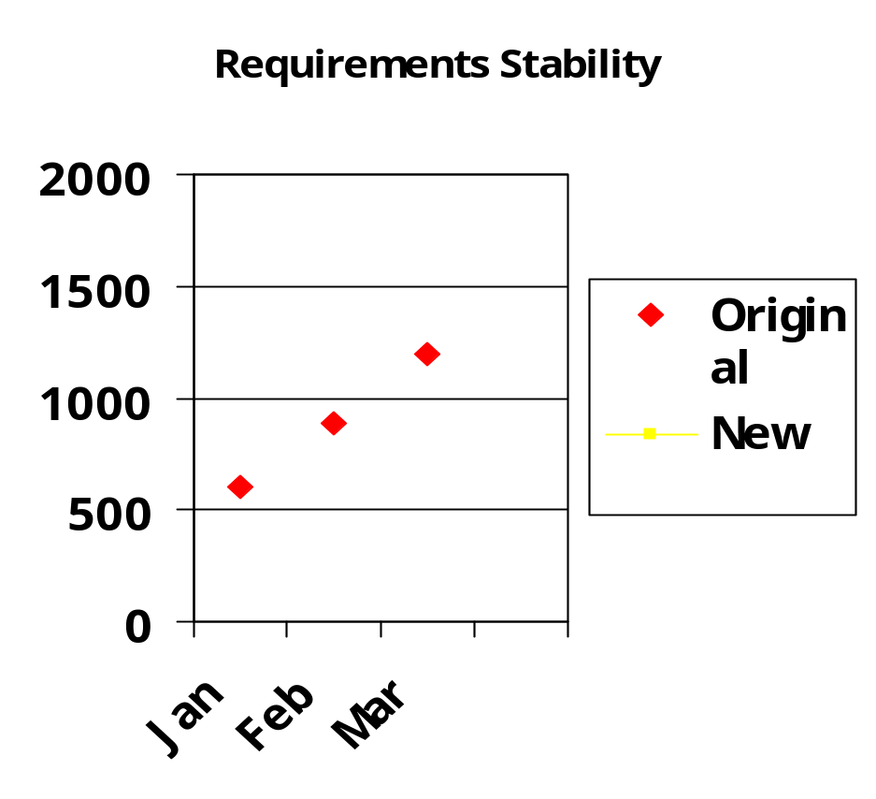
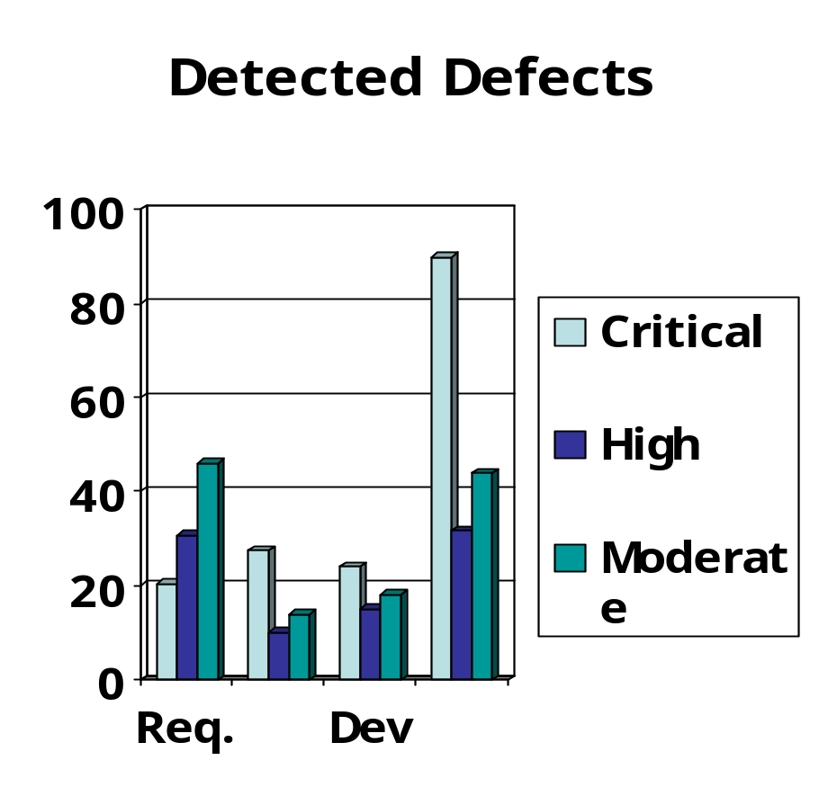
Sample Product Metrics
Baseline

Slide 30
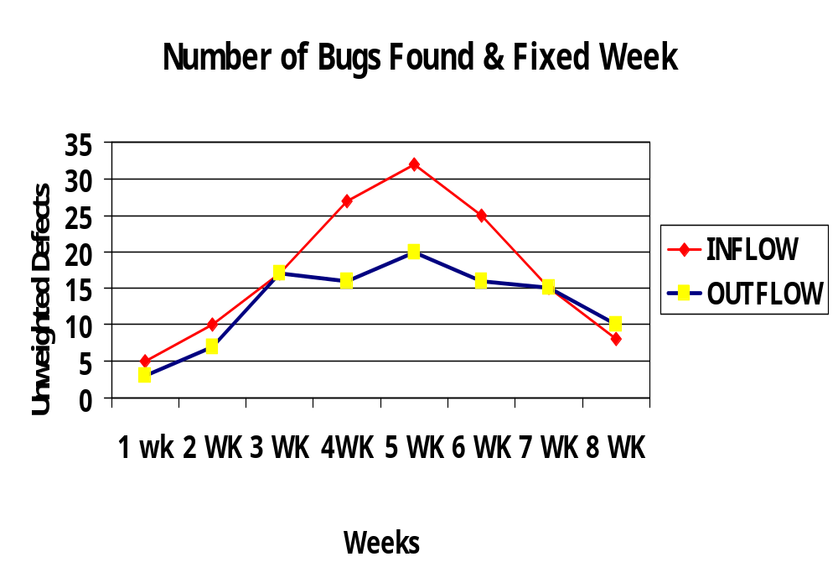
Product Stabilization
Notes:
Defect inflow is the number of buds detected over a time period.
Defect outflow is the number of bugs fixed each week. Typically this starts out slow (it can’t exceed the rate of inflow at first, until a backlog builds. It should grow and level off at a steady rate. This is representative of most projects.
Eight weeks is just long enough to see a trend

Slide 31
Weighted Defect Inflow
All bugs Are not created Equally
Defect Category | Weight
Critical | 20
High | 10
Medium | 7
Low | 3
Notes:
Since all bugs are not created equally, you can try weighted inflow and outflow tracking. By weighting the inflow you can get a much better feel for what is happening on project. For example, On most projects, there is a point at which testing is still finding lots of numbers,but they are lower in severity. IN this case you will see a weighed inflow drop[ wile un weighted inflow will typically remain constant. By measuring weighted defect inflow you’ll typically be able to forecast this important turning point in a project a few weeks earlier.

Slide 32
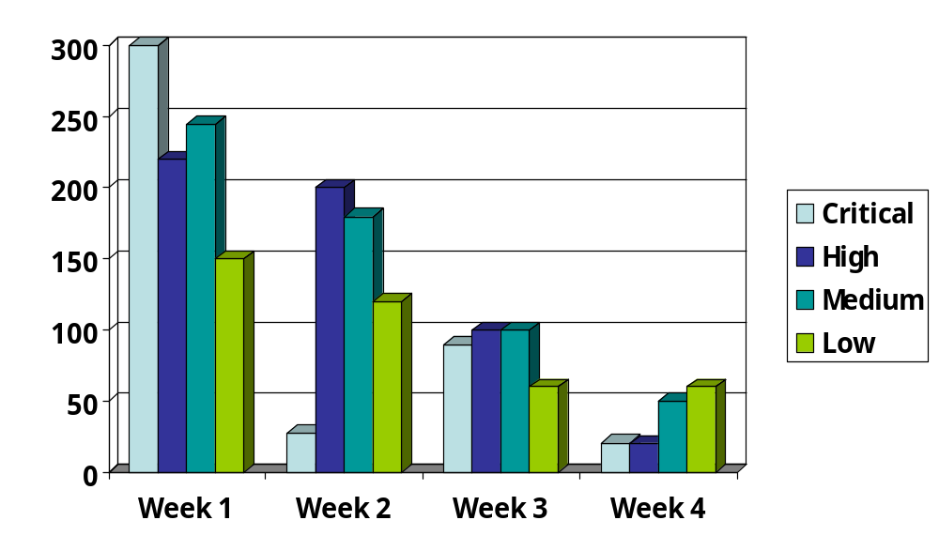
Weighted Defect Count
Notes:
Critical = 20 x 15, wk 2 10,wk3 = 5wk 4= 1
high = 10 x 22, wk 2 18,wk3 = 10 wk 4= 5
medium = 7 x 35, wk 2 28,wk3 = 15 wk 4= 10
low = 3 x 50, wk 2 40,wk3 = 20 wk 4= 20 bugs

Slide 33
Recidivism Rates
 | 5% Recidivism | 20% Recidivism
Bugs found during initial test runs | 1,000 | 1,000
Comeback bugs from initial test runs | 50 | 200
Comeback bugs from previous round | 2.5 | 40
Comeback bugs from previous round | 0 | 8
Comeback bugs from previous round | 0 | 1.6
Comeback bugs from previous round | 0 | 0
Notes:
This metric you should be careful about. It ;may be best to do on a team as a whole. Can establish a baseline recidivism rate, then establish a goal for the team, particularly when bonus’s etc are tied to it.
Knowing a team’s recidivism rate is extremely useful in predicting when a product will be ready for release. A team with 5% rate should be able to release a product after 3 passes (see chart) while a team with 20% rate will need more cycle.s
Example of use: project had 106 bugs remaining, and a 12% recidivism rate. In each new cycle got 1-2 bugs found by QA. Determined could send the product to QA after 80 bugs were fixed, of those 80 expected 12% (9.6) defects to come back, giving 9.,6 plus the 2 newly discovered bugs, plus 26 bugs not yet fixed, With 38 defects left and a 12% rate decided to need cycles or 3 cycles to QA.

Slide 34
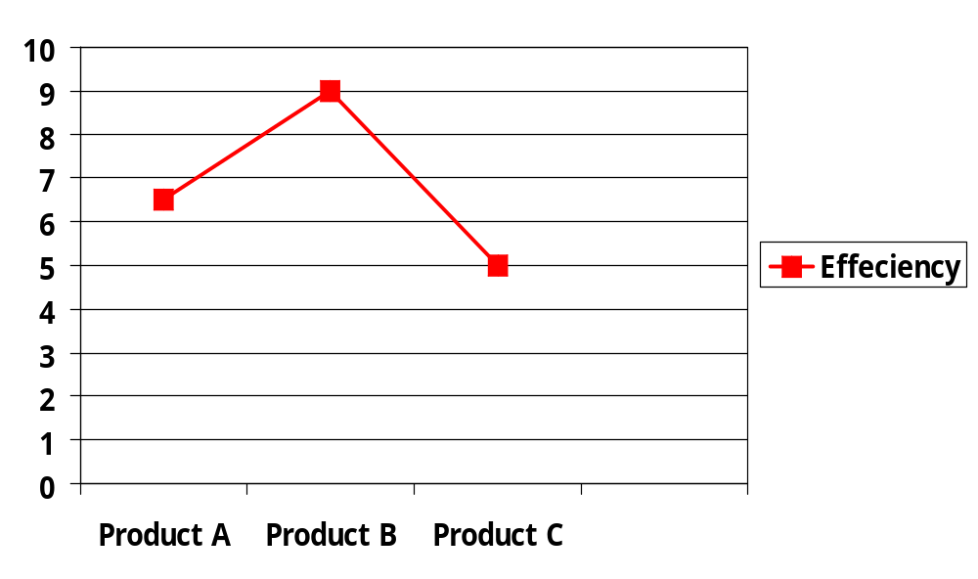
Defect Removal Efficiency

Slide 35
Metrics for Software Maintenance
Fix backlog
Backlog Management Index
Fix Response time and responsiveness
Percent delinquent fixes
Fix quality
Notes:
Fix backlog is a workload statement for software maintenance. It is related to both the rate of defect arrivals and the rate at which fixes for reported problems become available. It is simple count of reported problems that remain at the end of each month or week.
Backlog management index is number of problems closed during the month/ num of problems arrivals during the month times 100%

Slide 36
Metrics for Development Organization
SEA= actual project duration/estimated duration
FR= Num failures/execution time
Backlog Management
Inspection coverage and effort
Compile failures and build/integration defects
Defect cause and problem component analysis
Recidivism Rate
Notes:
SEA scheduled estimation accuracy
FR: failure rate

Slide 37
Cost / Value Based Metrics
Testing Benefit Vs. cost
Cost of Quality
Test cost (test cost vs. total system cost) identifies the amount of resources used in the development
or maintenance process allocated to testing.
Achieving budget (anticipated cost of testing vs. actual cost of testing) determines the effectiveness of using test dollars
Notes:
SEA scheduled estimation accuracy
FR: failure rate

Slide 38
Cost / Value Based Metrics
Effectiveness of test to business (loss due to problems vs. total resources processed by the system) shows the effectiveness of testing in reducing system losses in relationship to the resources controlled by the system being tested
Asset value of test (test costs vs. assets controlled by system) shows the relationship between what is spent for testing as a percent vs. the assets controlled by the system being tested.

Slide 39

Summary
Select a few metrics tied to goal
  Customer focus
  Product focus
  Organizational focus
Go graphic and easy to access

Slide 40

Questions?
???
???
cchaney@ppc.com

Slide 41
References
Establishing Effective Measurements in Support of the SEI CMM. Koni Thompson, PSQT/PSTT 2002 North
Metrics that Matter. STQE Magazine, January/February 2003. Marsha Holliday.
A Measured Response. STQE Magazine, September/October 2002. Mike Cohn
Software Metrics Overview. Addison Wesley Professional, December 20, 2002. Stephan Kan
Fundamental Metrics for Software Testing. Internet Development Associates. 2000

